Slide 1
Web Scraping Project Presentation
An overview of the web scraping project using BeautifulSoup and pandas
-By Shivam Pabrekar

Slide 2
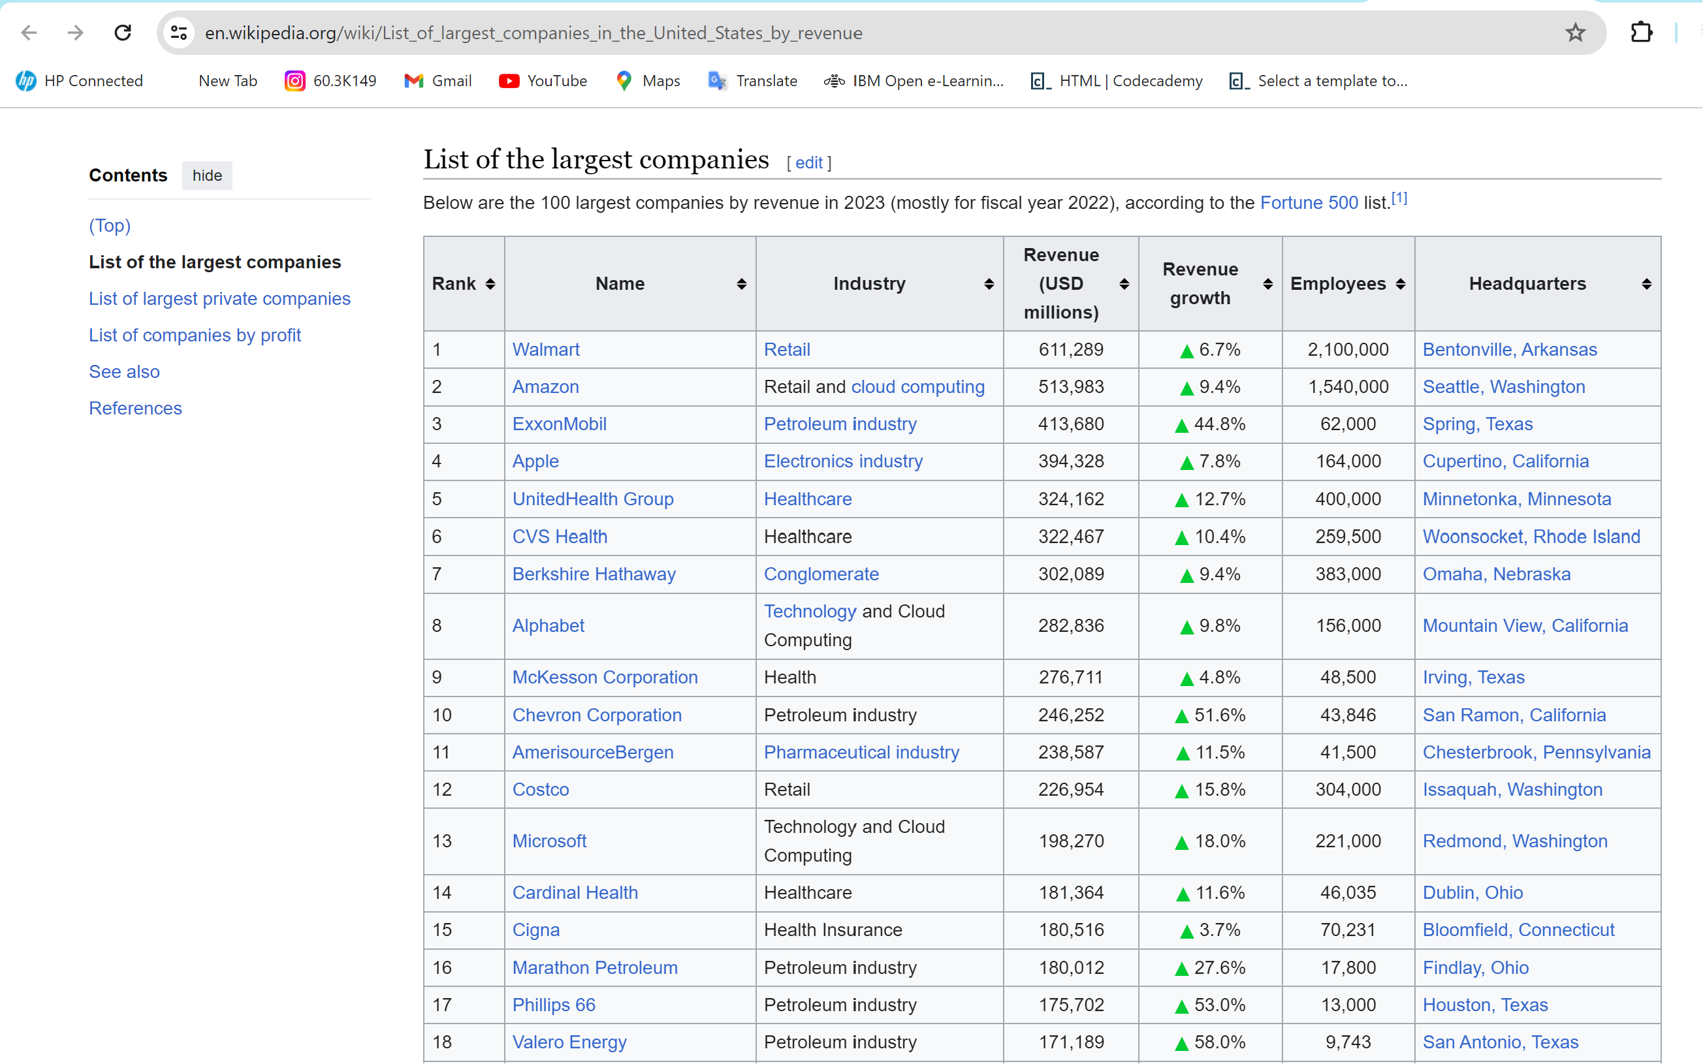
Introduction
This project involves web scraping to extract data from a Wikipedia page listing the largest companies in the United States by revenue.

Slide 3
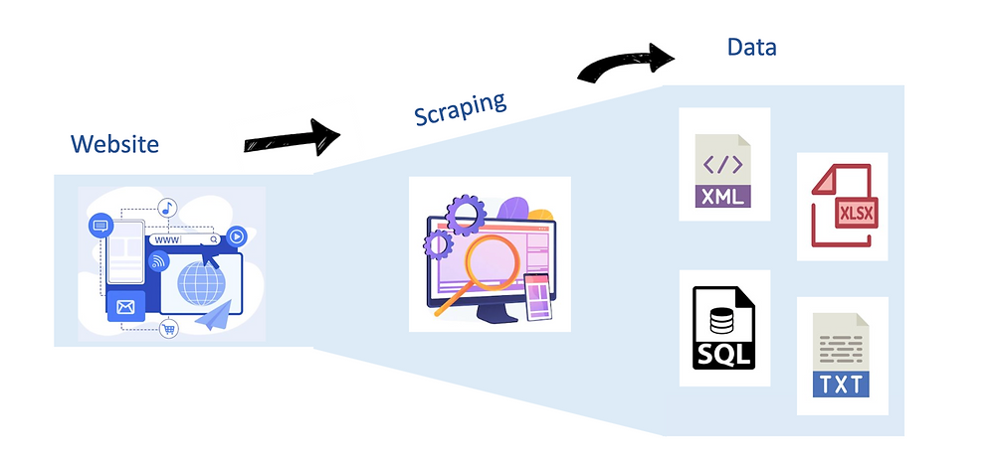
Working
1. The project uses BeautifulSoup for parsing HTML and requests for making HTTP requests to the target URL.
2. The data is extracted from a specific table on the webpage.
3. Pandas is utilized to organize the data into a DataFrame.
4. The final DataFrame is then exported to a CSV file.

Slide 4

Uses
1. Extracting data from web pages for analysis.
2. Automating data collection from websites.
3. Creating datasets for research and analysis.

Slide 5
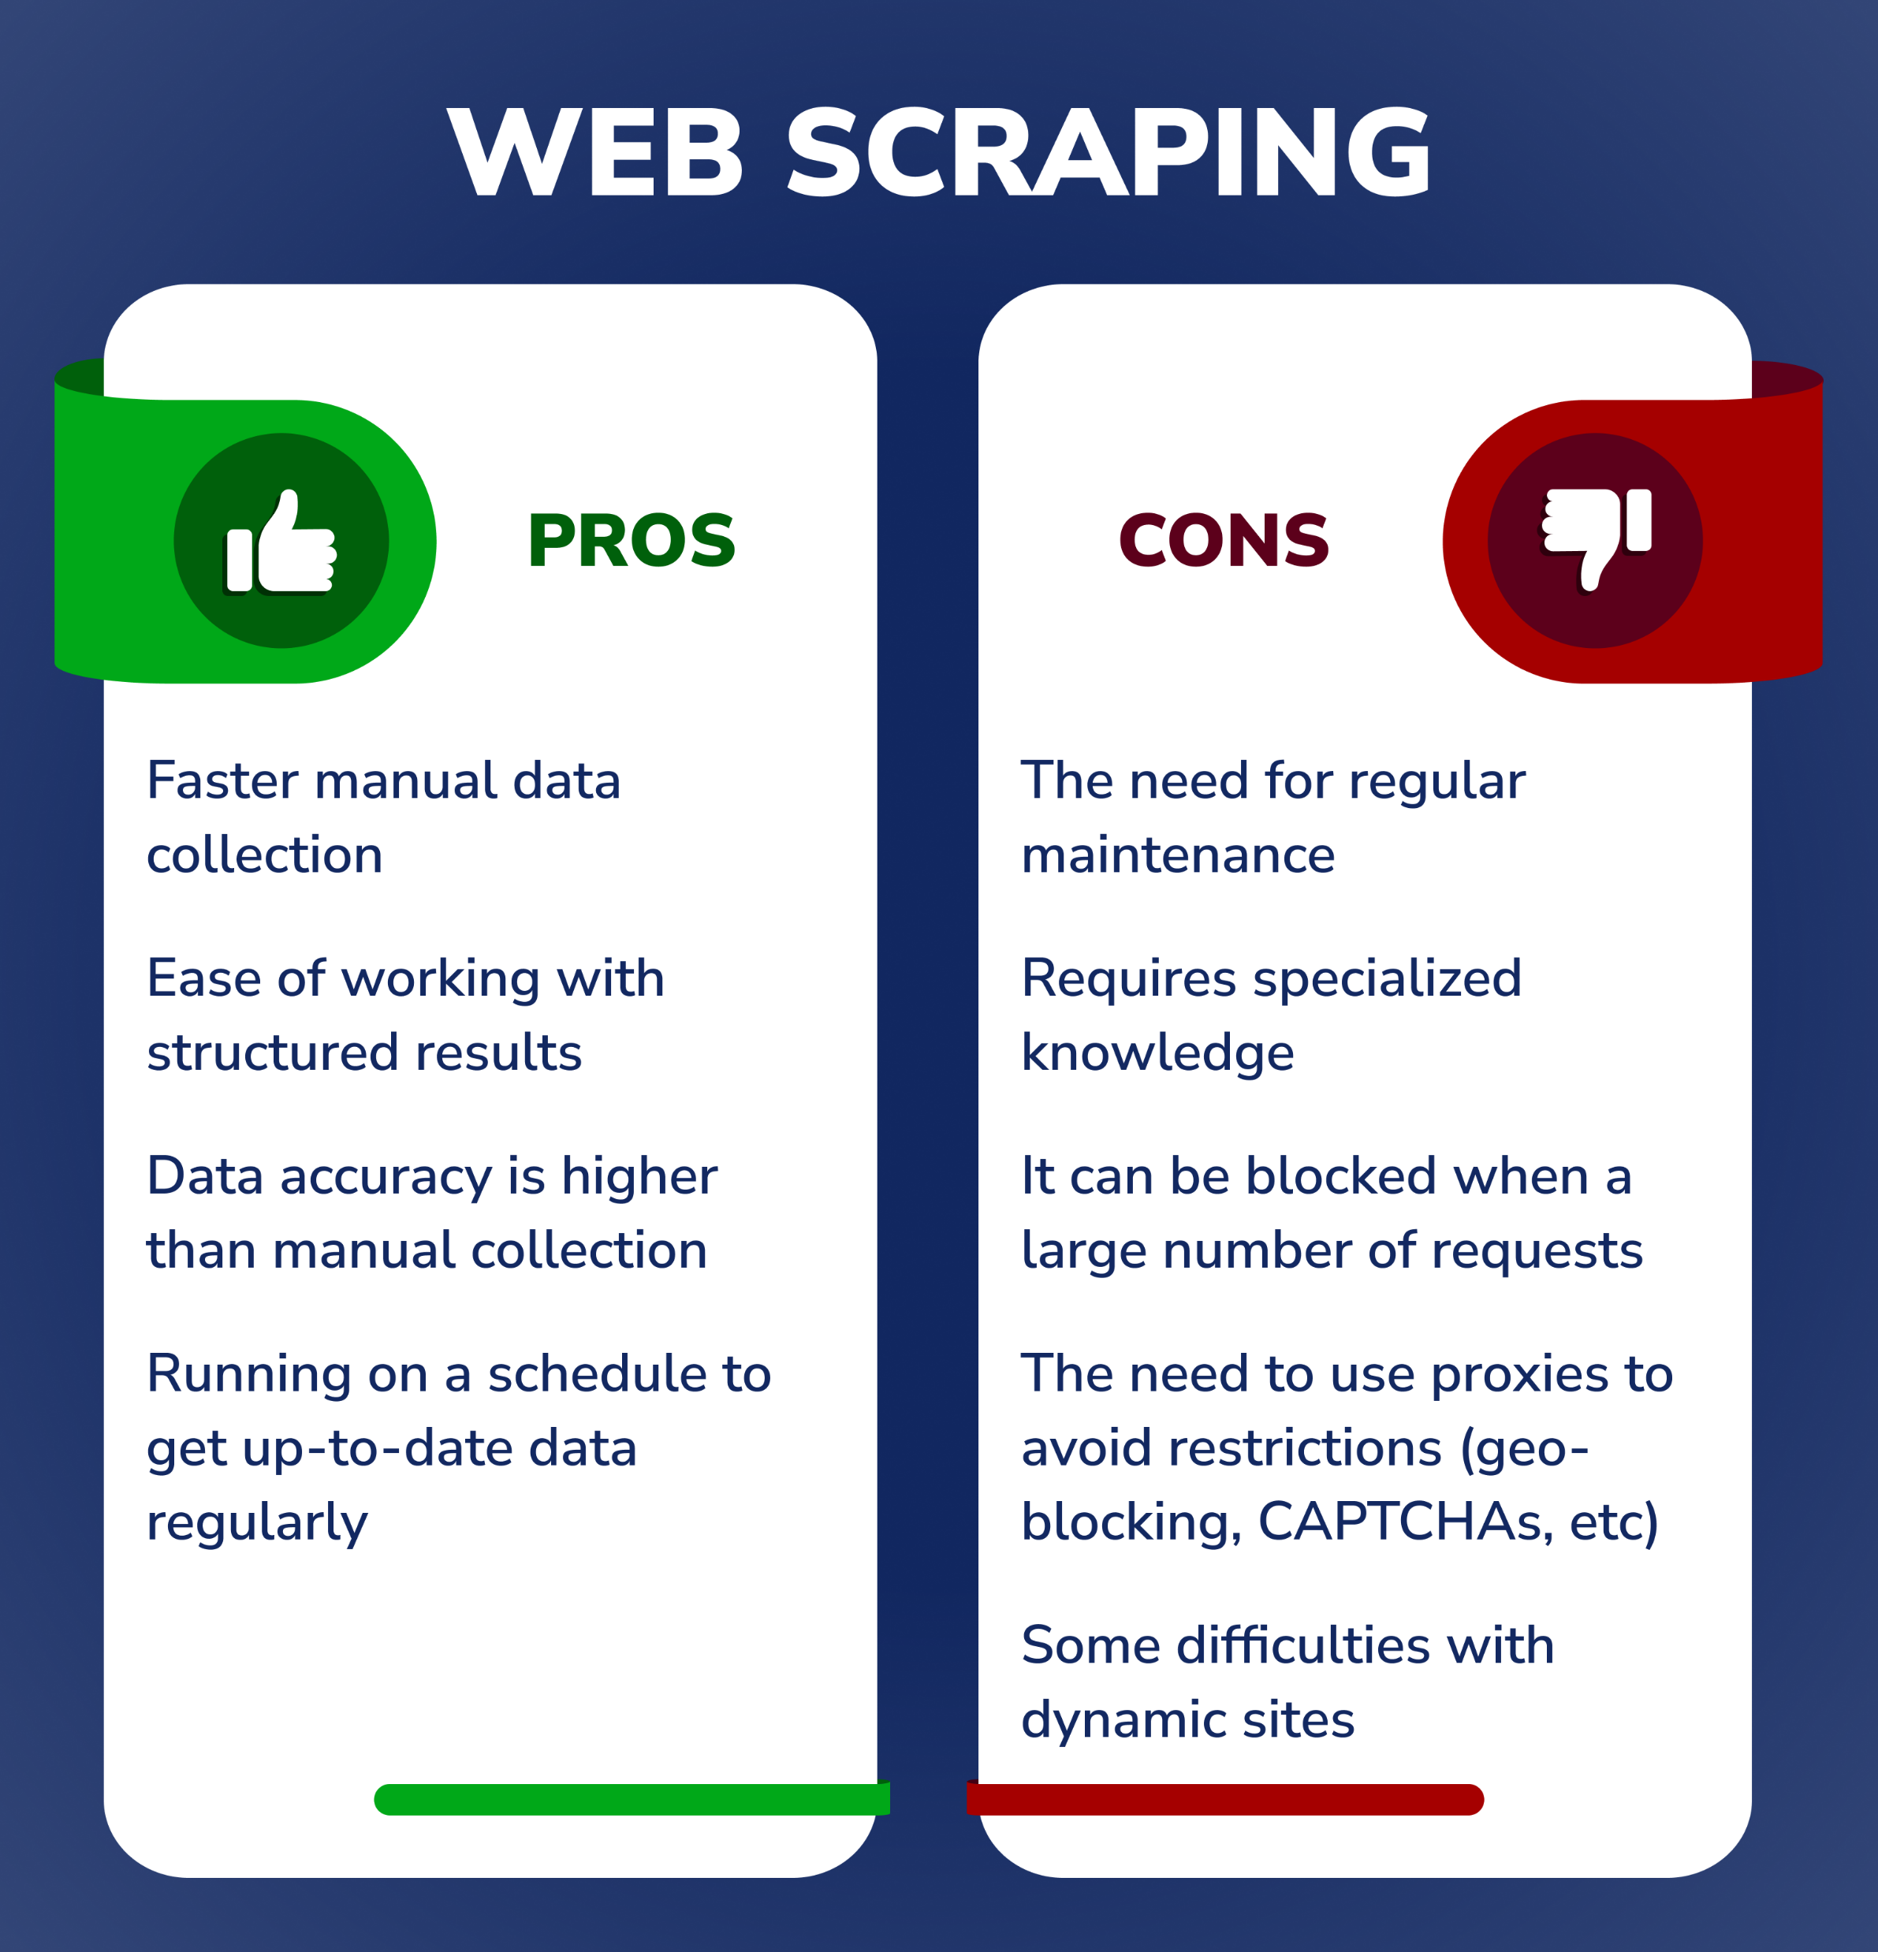
Advantages & Disadvantages
Advantages:
- Automation of data retrieval.
- Efficient for large-scale data collection.
Disadvantages:
- Legality and ethical concerns.
- Websites may block scraping bots.

Slide 6
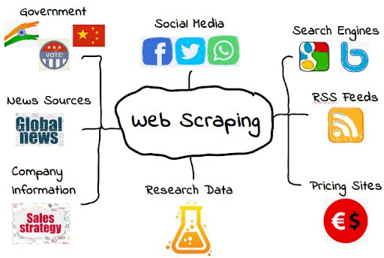
Future Scope
1. Implementing more advanced scraping techniques.
2. Handling dynamic content using tools like Selenium.
3. Building a user interface for easy interaction.

